Slide 1

What is your Privilege?
Socials Justice 12
Ms Leslie

Slide 2
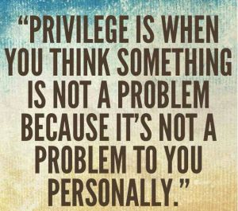
What is Privilege?
a social theory that special rights or advantages are available only to a particular person or group of people.
The term is commonly used in the context of social inequality, particularly in regard to age, disability, ethnic or racial category, gender, gender identity, sexual orientation, religion and/or
social class

Slide 3
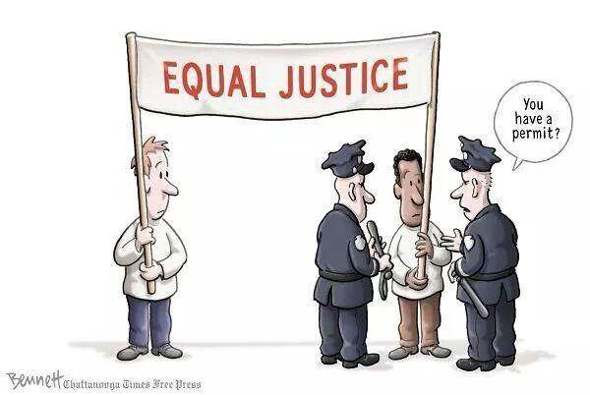
Having privilege doesn’t mean:
That you didn’t work hard to get where you are today
That you are a bad person
That you have done something directly to under privileged people
It doesn’t mean you’ve had an easy life, but perhaps is has been EASIER that others
Privilege doesn’t mean your life is easy or that you didn’t work hard. It simply means that you don’t have to face the obstacles others have to endure.
Let’s hear from Janaya Khan:
https://www.instagram.com/p/BpRTpsygj3R/?utm_source=ig_share_sheet&igshid=1jlod8ugcj305
The Protestors. Reused with the permission of the artist, Clay Bennett

Slide 4
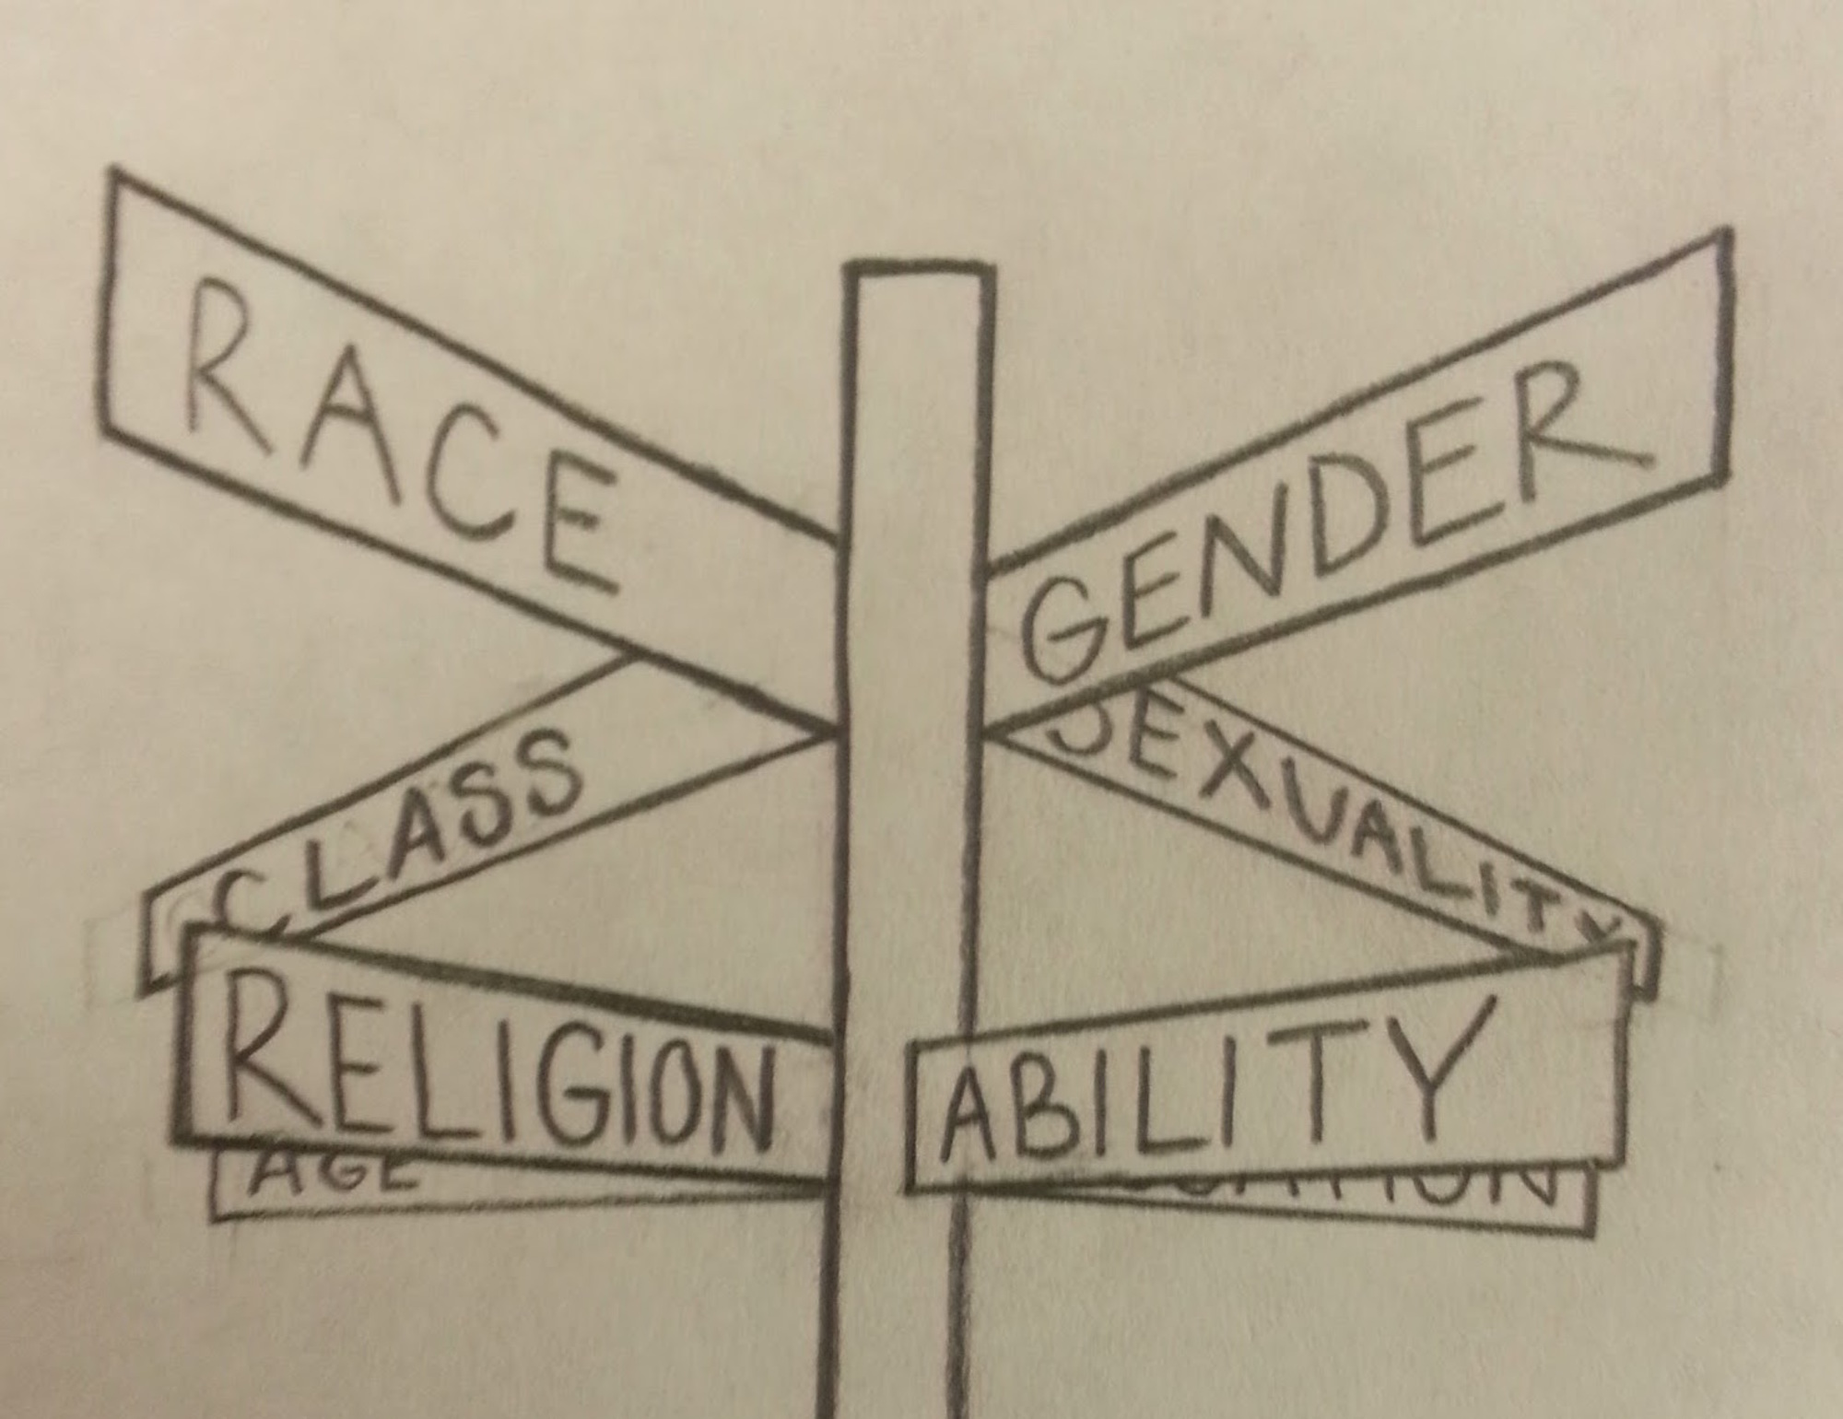
Intersectionality
Privilege simply means that under the exact same set of circumstances you’re in, life would be harder without your privilege.
Being poor is hard. Being poor and disabled is harder.
Being a woman is hard. Being a trans woman is harder.
Being a white woman is hard, being a woman of color is harder.
Being a Black man is hard, being a gay Black man is harder.

Slide 5
Activity time!
Take out a piece of paper for an activity!
Privilege walk from Australian Buzzfeed – everyone starts the same
https://www.youtube.com/watch?v=4K5fbQ1-zps
  Second example of a privilege walk – everyone has a different starting line.

Slide 6
Follow up assignment
In what ways are you privileged? In what ways are you not?
The videos we watched had the same metaphor of ‘the race of life’. How did they show privilege differently regarding the starting lines? Which one do you think is more reflective of the concept of privilege?
Why is it important to understand your own privilege? How would this help those who are less privileged?

